Slide 1
My Dream Car Assignment SUBMISSION
S.R. Ashank
DDA1610028

Slide 2
Abstract
The Purpose of the Assignment is to predict accurately the Miles per Gallon of a car based on the few parameters provided in the data set , mainly –
Number of Cylinders in a car
Volume of the Fuel inside the engine.( Also the size of the engine)
Pickup of the car (Horsepower)
Weight of the car
Acceleration of the car
Year the car was launched
Origin of the car
Car Company Name
Multiple Regression was used to model building and the final model consists of 5 variables with an accuracy of over 80% as per the Business Understanding. After Stepwise Reduction of Variables in the model, Variance Inflation factor was taken into account and all the variables with High VIF values and low significance were removed.
After eliminating all the variables with Variance Inflation Factor >2 (Business Decision) and removing the low significant variables, P-value based elimination is done so that variables with high p-values are removed from the model which ultimately have low significance.
In the end we are left with 5 variables which contribute to about 84% Accuracy in prediction of Miles per Gallon based on the abovementioned variables.

Slide 3
Problem Solving Methodology
1) Business Understanding
2) Data Cleaning
3) Data Preparation
4) Model Development
Stepwise Reduction of Variable
Variance Inflation Factor
Missing value Treatment
Outlier Treatment
Creating Dummy Variables
Creating Training and Test dataset
P-Value Criteria
6) Model Acceptance
5) Model Evaluation and Testing
Test R Square
Predict Values
Yes
NO
Goto 4

Slide 4
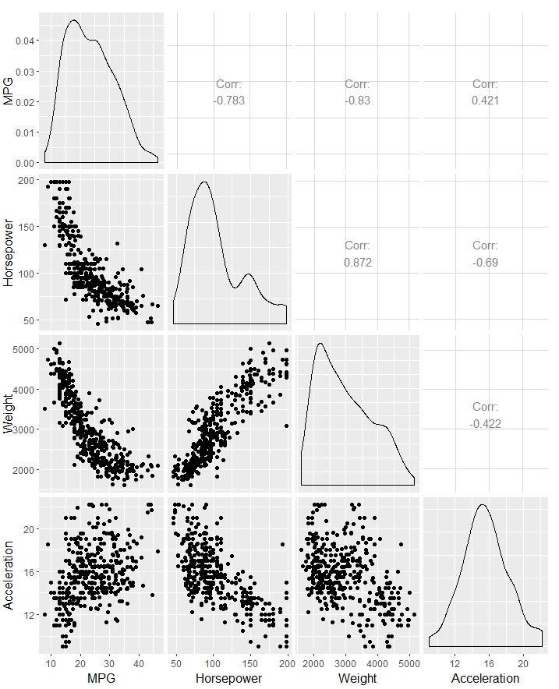
Correlation of Variables in the Given Dataset

Slide 5
Main Variables in the Final Model
The Main Variables that are in the Final Model with which we can do a prediction of Miles per Gallon are -
Weight of the Car
Cars with Number of Cylinder = 6
All Cars Manufactured after the year 2012
All Cars Manufactured before year 2006
Datsun Company
Equation of Prediction = 41.8729985 - 0.0063584(Weight) - 2.1459228(Cylinder=6) - 2.2156075(Above 2012 Year) + 5.8433337(Below 2006 Year) + 2.1297711(Datsun Company)

Slide 6
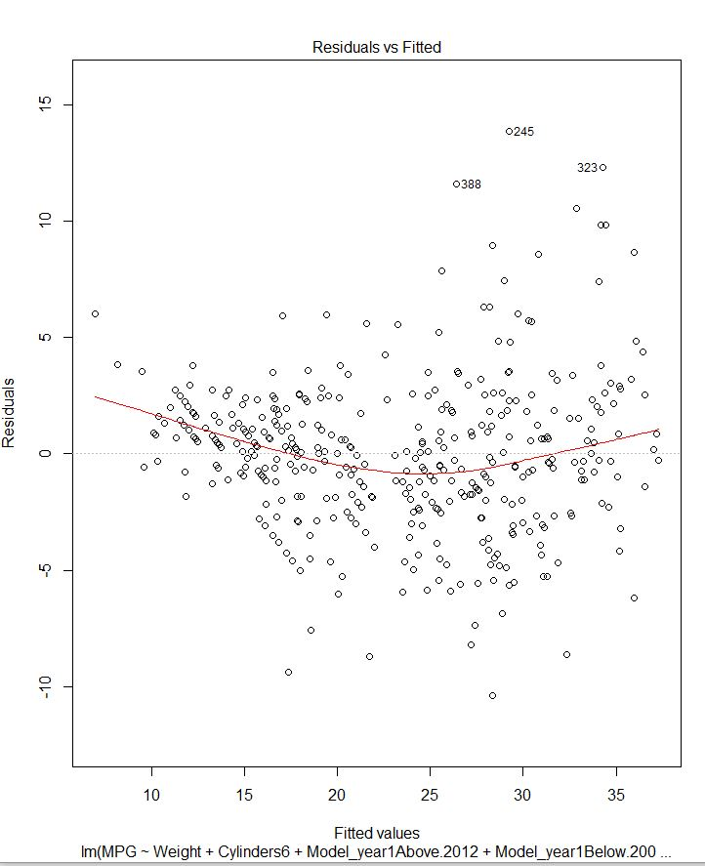
Accuracy of Model and its Prediction
The Model produces an accuracy of 82% with a Variance Inflation Factor of 5 variables below 2 as per the Business Decision.
Subsequently, the accuracy of prediction of the Mileage of the car holds 84% accuracy as compared to the market Survey.
The Residual Plot shown here indicates a good model as non-linear relationship is explained in the plot.

Slide 7
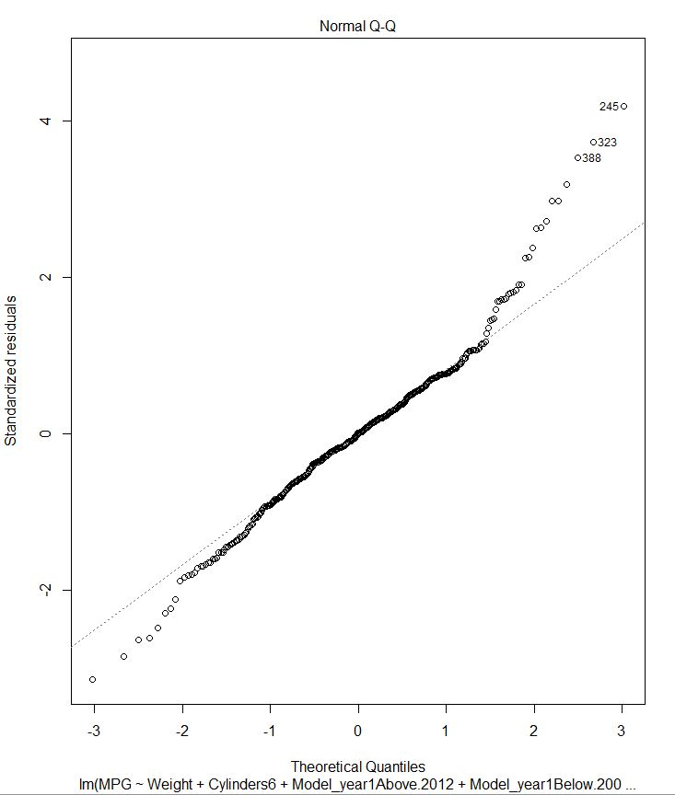
Normal Distribution of Residuals in the Model
The Graph indicated on the side indicates that our Model works close to a normal distribution, which in turn, is an indicative of a good Model.

Slide 8
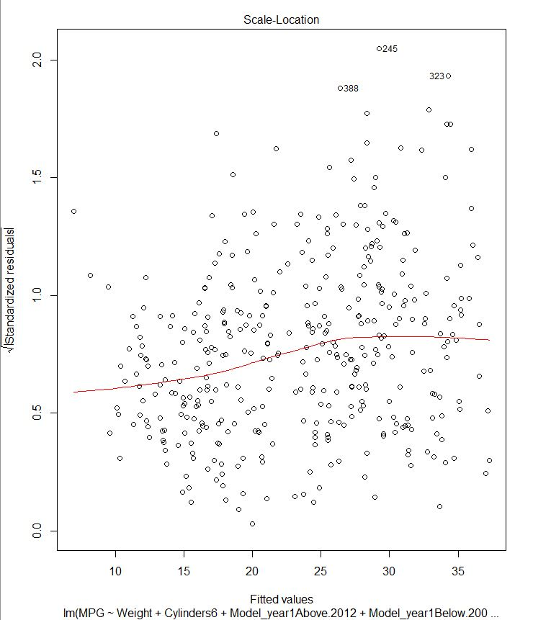
Even Spread of Residuals in the Predicted Model
The Plot indicated here shows the spread of all the residual values amongst the Predicted Model Built.
The distribution across the line of prediction indicates the even spread of the residuals.

Slide 9
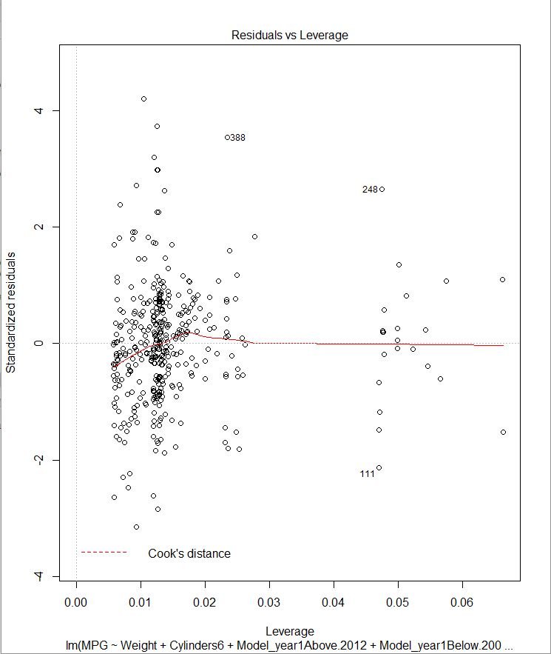
No Influential Cases in the Model
The Model does not have any influential cases.
Influential cases are those values where the extreme values, influence the regression line, i.e, they can alter the values of a regression analysis.
It is safe to say that the model built is free of any influential case.

Slide 10
CONCLUSION
Recommendations
It is preferable to show cars manufactured by Datsun Company to the customers
Cars launched before 2006 recommended for high mileage.
Suggestions
Avoid recommending cars that have been launched after 2012 as they tend to contribute in a negative way to the mileage.
Avoid recommending cars that have 6 cylinders.

